Slide 1
Architecture Principles

Slide 2
Why Architecture Principles Matter for the Data Strategy?
Architecture principles provide the guardrails that align business and technology teams on how data is designed, governed, and consumed at scale - ensuring speed, trust, and future‑readiness without increasing risk.
  Create enterprise alignment by establishing a shared set of non‑negotiables across domains and delivery teams
  Accelerate delivery and reduce rework by removing ambiguity and inconsistent architectural decisions
  Embed trust, security, and compliance by design, rather than relying on manual or after‑the‑fact controls
  Enable reuse and compounding value through standardized, product‑based data patterns
  Future‑proof the platform by ensuring today’s data investments are scalable and AI‑ready

Slide 3






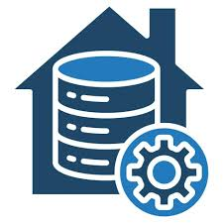


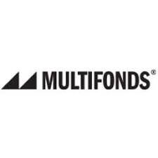


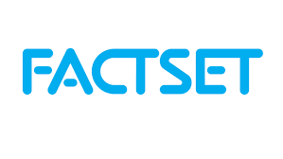


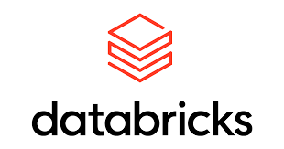


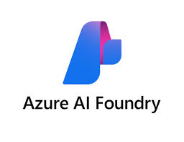



Canada Life’s Next-Gen Unified Data Platform for Insight, Innovation, and AI
A modern data foundation that standardizes how insights are created, shared, and operationalized at scale
Enterprise Sources
The Next-Gen Unified Data Platform
Enterprise Intelligence
NORTH
(Next-Gen Organizational Repository for Trusted and High Value Data)
Enabled User Journeys
Canada Life
Data Repositories
Governed & High-Quality Data Products
Information Access Layer
AI: Gen AI/ Agentic AI / ML
Business datamarts
Experience: Enterprise Applications & Omni-Channel
Data Supply Chain
Insights: Self Serve Analytics
Canada Managed Lifeco Data
Business Intelligence: Reporting
External
Governance, Security & Metadata
Structured Data | Transactional Data | Unstructured Data | Documents | Voice
*Note: Data sources & Enterprise Intelligence technologies are not exhaustive and may evolve

Slide 4
Canada Life's Data Value Chain – Key Principles
These enterprise-wide principles guide how data is captured, governed, and consumed to realize the full value of the NORTH Platform
Today, Canada Life relies heavily on manual reporting and fragmented data assets, resulting in inconsistent insights and slow time to value. The NORTH Platform addresses these challenges by enabling incremental, reusable data products that are governed once and leveraged broadly across the enterprise.
To deliver this shift, the platform is underpinned by clear enterprise principles—ensuring data is captured comprehensively, standardized and governed at the source, built once for reuse, and made accessible through a single, trusted access layer. Together, these principles enable business teams to rapidly generate trusted reporting, advanced analytics, and AI-driven insights at scale.
1
All source data across Canada Life, Canada Managed Lifeco Data, and external providers, both structured and unstructured is captured and ingested into the NORTH Platform for Enterprise Intelligence & AI needs
2
Data Pipelines and Repositories standardize and harmonize ingested data, ensuring it is consistent, trusted, and ready for enterprise-wide reuse.
3
Incremental Data Products are built once and reused across dashboards, models, regulatory reporting, and channels. As new products are added, value compounds through single-source, governed data
1
4
3
4
6
The Information Access Layer delivers a common set of access patterns for all enterprise data consumption
2
5
The Data Governance layer embeds policies, standards, metadata, and lineage across the data lifecycle, ensuring all critical data sources and data products are secure, trusted, certified, and aligned to enterprise definitions
5
6
The Consumption layer delivers business value by enabling insights, decision support, and trusted reporting across business, client, and operational use cases.

Slide 5

Architecture Principles – Data Integration & Movement
Follow Integration Patterns: Use standardized, reusable components for batch, API, and streaming data flows.
Version your interfaces. Changes to payloads or schemas are versioned and communicated; breaking changes include a migration plan.
Hub-and-Spoke Execution Model: Central teams provide shared tools and patterns, while Tech business units build and run their own pipelines.
Policy-as-Code Enforcement: Define and enforce data access, quality, and routing rules as code embedded in pipelines.
Resiliency and Observability: Design pipelines with built-in error handling, monitoring, and alerting to ensure reliability.
Timely Data Availability by Design: Choose batch, near real-time, or streaming based on business need. Prioritize real-time and event-driven patterns when latency impacts decisions or operations.

Slide 6
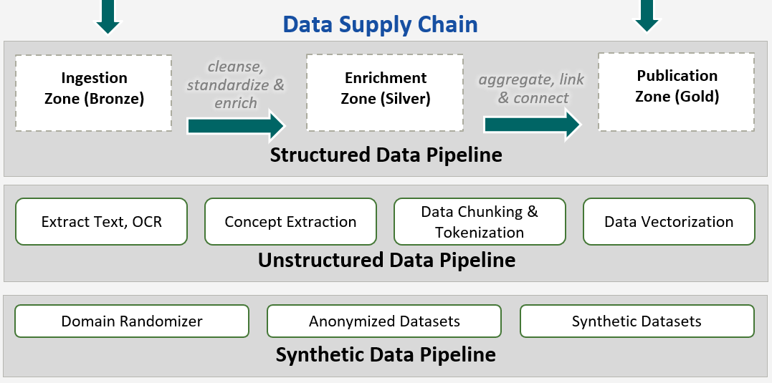
Architecture Principles – Data Pipelines (structured, unstructured, synthetic)
Standardised Architecture Blueprints: Use consistent platform and solution data architecture designs to ensure scalability, security, and reuse.
Automate. Use CI/CD to build, test, and release pipelines like software.
Quality by design. Validate accuracy, completeness, and timeliness at each step - don’t wait until the end.
Domain-Based Modelling: Structure data using shared and common conceptual reference domain models to support consistency and interoperability.
Tiered Storage Design: Store data in ODS and CDP ingestion (raw), enrichment (curated), and publication (trusted) zones with clear lifecycle and access policies.
Operational and Analytical Separation: Use BU-level ODS for intraday operational needs; use Enterprise Data Lake (CDP) for cross-BU data integration, consolidation, and analytics.
Data Replication to CDP: All BOR, derived data and mastered data must be replicated to the CDP using secure, automated, and auditable processes.
CDP as Primary Analytical Platform: CDP should be the primary data warehousing and analytical platform across Canada Life. All on-prem and legacy data marts and warehouses must be migrated to CDP.
Automation of testing: Generate synthetic and masked test data through AI enabled test data management tools and services.

Slide 7
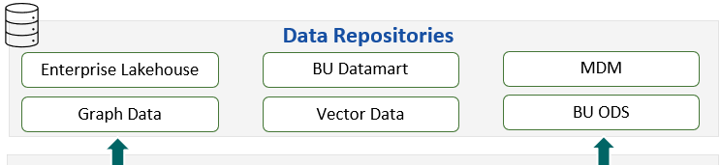
Architecture Principles – Data Repositories (lakehouse, ODS, MDM, graph, vector)
Master once, use many. MDM holds the golden records (Customer, Advisor, Product) with clear stewardship and match rules.
Graph adds context. Use knowledge graphs for relationships, rules, and institutional knowledge you need for reasoning and explainability.
Vectors power retrieval. Keep embeddings in domain partitions with access controls; use them for secure RAG and semantic search.
Enforce policies at run‑time. Authorization and filtering happen dynamically when data is used- not only when it’s stored.
Plan for change. Schema evolution is controlled and tested; consumers get notice and safe rollout windows.
Dispose responsibly. Retention and deletion are automated and auditable for all repository types (including vectors and graphs).
Authoritative sources: Assign a single system of record for each critical data element (CDE) or entity. Book of Record (BoR) is always the first point of data lineage. Data marts, Data Lake, and ODS cannot be treated as BoR but can be certified as Derived Records. Mastered Records are governed in MDM.
Mastered data sources: Governed MDM hubs for Customers, Advisors, and Products. Federated stewardship for Clients and Prospects.
ODS is operational *, CDP is analytical *. ODS serves intraday and daily operational reporting in a BU; CDP (the lakehouse) serves cross‑BU analytics and sharing.
* Operational reporting: Information used to run day‑to‑day activities right now (near‑real‑time metrics and status for operational decisions).
* Analytical reporting: Information used to understand trends and outcomes over time (curated data that explains patterns and guides future decisions)

Slide 8
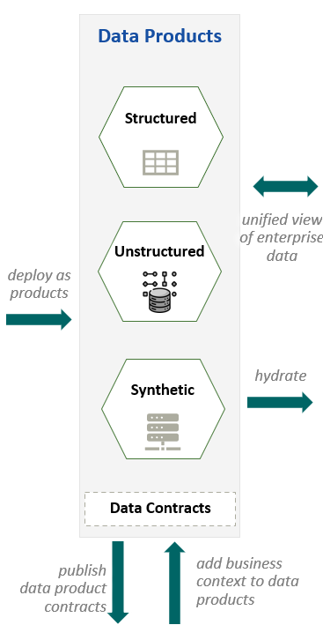
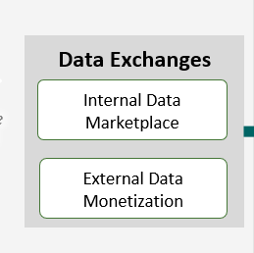
Architecture Principles – Data Products & Marketplace
Product over dataset. Every gold asset is a data product with an owner, a contract, SLAs, and a support channel.
Show the lineage and score. Each product displays where it came from and a simple quality scorecard.
Version like software. New releases are immutable; breaking changes come with consumer guidance and rollback plans.
Monetize with care. External sharing uses anonymized/aggregated products with explicit rights and privacy approvals.
Publish data product. Publish every data product through a few governed channels -SQL, APIs, BI semantic models, streaming, and federated queries - with policy‑as‑code, catalog registration, audit trails and EUC extracts only by exception.
Easy to find, easy to request. Publish products in the internal marketplace with clear descriptions and sample queries.

Slide 9
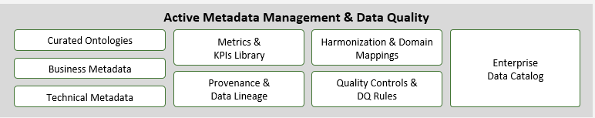
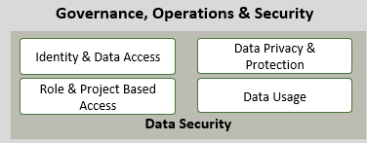
Architecture Principles – Governance & Security
Policy automation: Drive compliance through catalog, lineage, and policy-as-code.
Automate controls. Policies live in the catalog and pipelines; enforcement is continuous and logged.
Least privilege, always. Grant access by role and project context; bulk exports from production are blocked by default.
Audit trails by default. Keep simple, searchable logs for who accessed what, when, and why.
Own the data. Every domain has named owners and stewards who approve changes and access.
Clear ownership: Assign stewards and owners for domains and assets.
Lifecycle control: Apply retention and disposition by design with monitoring.
Federated Governance: Central standards, decentralized execution.
Transparency: Monitor compliance and provide dashboards.

Slide 10
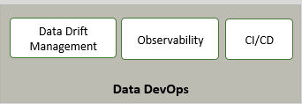
Architecture Principles – Data DevOps & Operations
Ship small, ship often. Use CI/CD for pipelines, policies, and semantic artifacts; aim for safe, frequent releases.
Watch for drift. Detect data and model drift early; alert owners with clear actions.
SLOs beat slogans. Define freshness, availability, and accuracy targets; report them openly.
Incident playbooks. Have runbooks for data incidents with roles, steps, and communication templates.

Slide 11
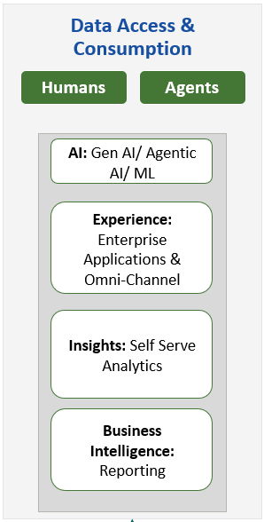
Architecture Principles – Presentation & Applications (humans & agents)
Self-Serve Enablement: Automate access to data and provisioning for business users.
Governed BI: Standardize BI platforms, models, and promotion paths.
Policy-Driven Access: Enforce access controls, audit trails, and EUC restrictions.
Observability: Monitor usage, SLA compliance, and error rates.
EUC Principle: Restrict production data downloads; require documented exceptions for regulatory and critical business needs.
Value Measurement: Track and report outcomes from data initiatives.
Platform Enablement: Use scalable platforms for analytics and AI.
Reusability: Leverage trusted datasets for multiple use cases.
Design for trust. BI, apps, and agents show sources, update times, and product owners.
Self‑serve, not self‑risk. Give business users simple, governed tools to explore safely.
Agents follow rules too. AI agents use the same policies, semantic layer, and audit trails as humans.

Slide 12
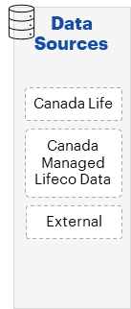
Architecture Principles – Data Sources
Data ownership. Business is accountable for each domain; data is captured consistently with tags, lineage, and a simple data contract.
Respect privacy at the edge. Apply consent and usage rules as close to the data source as possible.
Keep residency rules. Route data to the correct country/segment and don’t move it across segments without approval.
No shadow feeds. All connections to sources use approved connectors with approved contract and show up in monitoring.
Metadata-First Design: Automatically tag all data with business and technical metadata at the point of creation for reuse and AI explainability.
Domain-Aligned Classification: Label data based on business domains to support reuse, governance, and discovery.
Embedded Lineage Tracking: Capture and visualise data origin and flow to support audit, compliance, and AI readiness.
Automated Discovery Enablement: Enable cataloguing tools to scan and index new data assets across structured and unstructured sources, and sources should allow discoverability of their datasets
Standardised Naming and Format: Use consistent names and labels to make data easy to find, understand, and integrate aligned to defined enterprise data standards.
Contract before connect. Every source needs a simple data contract (what the data is, how fresh it is, who can use it, retention, and quality expectations).

